Slide 1

Advanced Database Topics Redis "the Swiss army knife of databases"
Notes:
Replace this with your course title and your name/contact details.

Slide 2
NoSQL database types
Key/value
With a key/value storage format, data uses keys, which are identifiers that are similar to a primary key in a relational database. The data element itself is then the value that corresponds to the key.
Column
With a column-oriented data store, data is arranged by column rather than by row. The effect of this architectural design is that it makes aggregate queries over large amounts of data much faster to process.
Document
Document data storage in NoSQL uses a key as the basis for item retrieval. The key then corresponds to a more complex data structure, called a document, which contains the data elements for a given collection of data.
Graph
Graph databases use graph theory to store data relations in a series of vertices with edges, making queries that work with data in such a manner much faster.

Slide 3
What is Redis
Redis is a different evolution path in the key-value DBs where values can contain more complex data types, with atomic operations defined on those data types.
Redis data types are closely related to fundamental data structures and are exposed to the programmer as such, without additional abstraction layers.
Redis is an in-memory but persistent on disk database, so it represents a different trade off where very high write and read speed is achieved with the limitation of data sets that can't be larger than memory.
Redis is a NoSQL database and yet much more. Redis is a multimodel database enabling search, messaging, streaming, graph, and other capabilities beyond that of a simple data store.

Slide 4
Why Redis
Consider the example of wanting to get user preferences every time they login.
The preferences would be stored as a JSON document
The underlying idea behind Redis is very straightforward: to read and write as much data as possible in RAM. As the majority of the operations do not include disk or network I/O, Redis is able to serve data very quickly.
Redis exists all in-memory; thus about 100x faster than querying a database.
Good for things that need to be queried constantly and often. Things that are very easily looked up. You have a key and you want to quickly get the value.
Redis can be used as a means to cache data between the application and the backend data store,
Thus is often paired with another relational or NoSQL database.
Doing so frees up that database for other operations while Redis handles the user-friendly, fast response.
Redis also can handle geospatial and time-series data and is also used for fast-moving data – useful for message queueing and delivery

Slide 5
Why not Redis? (Redis Anti-Patterns)
Redis is not good for managing relationships; not good for highly relational data
Redis is not good for storing incredible amount of details.
Redis is not good for data discovery.
Redis is not good for data transformation, ala data warehousing or ETL
Redis is designed to be accessed by trusted clients inside trusted environments. This means that usually it is not a good idea to expose the Redis instance directly to the internet or, in general, to an environment where untrusted clients can directly access the Redis TCP port or UNIX socket.
Dataset cannot fit into RAM
Redis' greatest asset is its speed, due to the fact that data is written to and read from RAM. If your dataset cannot fit into RAM, then disk I/O begins to enter the picture (as memory is swapped to disk) and performance can quickly degrade.
The KEYS command is expensive in large databases

Slide 6
Redis Data Storage
Redis keeps data in memory for fast access and persists data to storage, as well as replication of in-memory contents for high availability production scenarios.
Durability is the ability to ensure that data is available in the event of a failure of a database component.
Redis supports multiple modes for ensuring durability, accommodating most data structures and environment-specific requirements
Supported data structures include
Strings
Lists
Sets
Sorted sets
Hashes
Bit arrays
Streams
HyperLogLogs
The term instance in Redis represents a redis-server process.
Multiple instances of Redis can run on the same host, as long as they use different configurations, such as different binding ports, data persistence paths, log paths, and so on.

Slide 7
The Redis protocol RESP (1)
RESP commands for how a Redis client and Redis server talk to each other
The command begins with an asterisk indicating this is an arrays type.
1 stands for the size of this array.
\r\n (CRLF) is the terminator of each part in RESP.
The backslash before $4 is the escape character for the $ sign. $4 tells you that the following is a bulk string type of four characters long.
PING is the string itself.
+PONG is the string the PING command returned. The plus sign tells you that it's a simple string type.

Slide 8
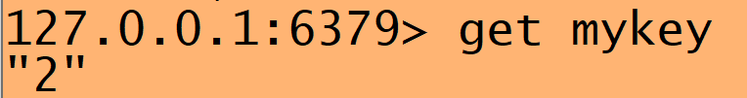
The Redis protocol RESP (2)
RESP commands for how a Redis client and Redis server talk to each other
If you have a new language on your hands and no Redis driver, it is good to know that the protocol is so simple and readily implementable in even the most constrained of languages. As long as you can open a TCP socket to a port and read/write to it, you are good to go.
For Simple Strings the first byte of the reply is "+"
For Errors the first byte of the reply is "-"
For Integers the first byte of the reply is ":"
For Bulk Strings the first byte of the reply is "$"
For Arrays the first byte of the reply is "*"

Slide 9
Redis, CAP and ACID

Slide 10
Redis and CAP
Redis (single node)
When looking at Redis within the context of Brewer's CAP theorem, its designation would be as a CA system
It earns this designation by being able to support both consistency (C) and availability (A), while partition tolerance for a single instance configuration is not a concern.

Slide 11
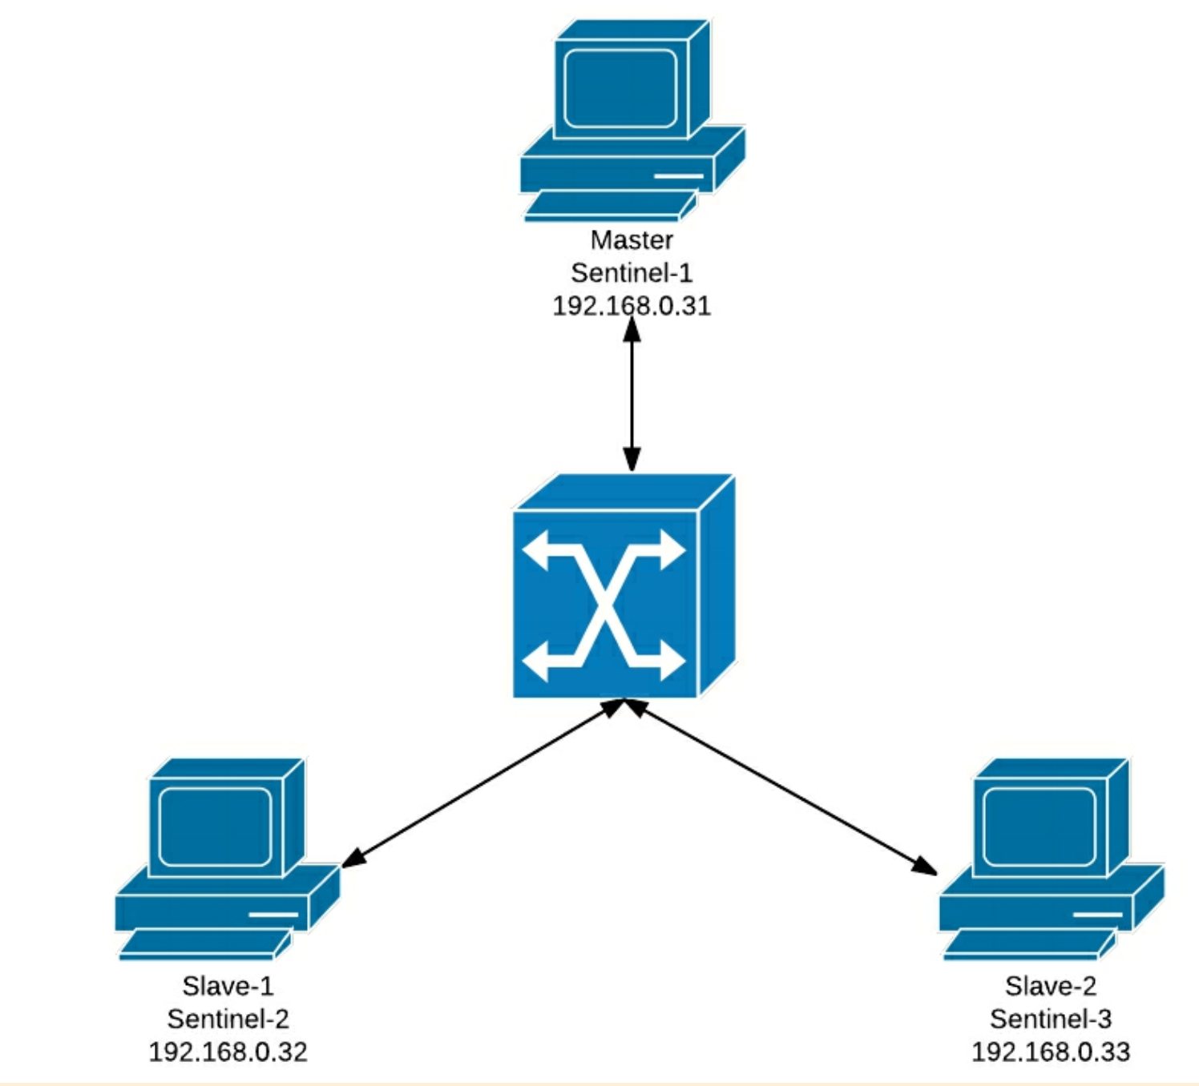
Redis Cluster and CAP
Redis Cluster
Redis's creator Salvatore Sanfilippo states that Redis Cluster is more biased toward consistency than availability.
Yet, there are times (however small) when acknowledged writes may be lost during re-hashing or election periods.
It is also possible that slave nodes can be configured to serve dirty reads, with the client potentially reading stale data during a small window of time. This (like many NoSQL databases) allows Redis to continue to serve its data during periods of server or (partial) network outages.
These factors make it difficult for Redis to fully support strong consistency, despite its intent.
Redis Cluster earns an AP CAP designation.
Reading stale data is not sound desirable, BUT the alternatives of returning an error or making a client application wait for consistency to be achieved can be even more undesirable. For instance, in a high-performance web client environment, the possibility of returning stale data (say, for a small window of double-digit milliseconds) is preferable to returning nothing.

Slide 12
Redis and ACID
Atomicity: Redis provides transaction-related commands, including WATCH, MULTI, and EXEC. These commands ensure that operations on the database are indivisible and irreducible.
Consistency: Only permitted writes are allowed to be performed through the validation provided by Redis.
Isolation: Being single-threaded, each single command or transaction using MULTI/EXEC is thereby isolated.
Durability: Redis can be configured to respond to a client write to confirm that a write operation has been written to disk.

Slide 13
Working in Redis

Slide 14
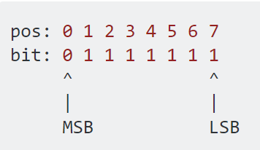
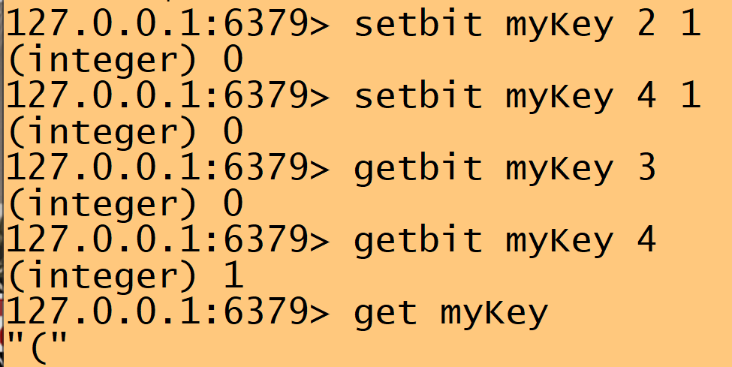
Storing Simple Data
Strings
SET user Steve
GET user "Steve"
Counters
SET logincount 1
INCR logincount (integer) 2
GET logincount "2"
SETBIT myVal 2 0
logincount 1
Bitmaps
0 0 1 0 1 0 0 0 = 40

Slide 15
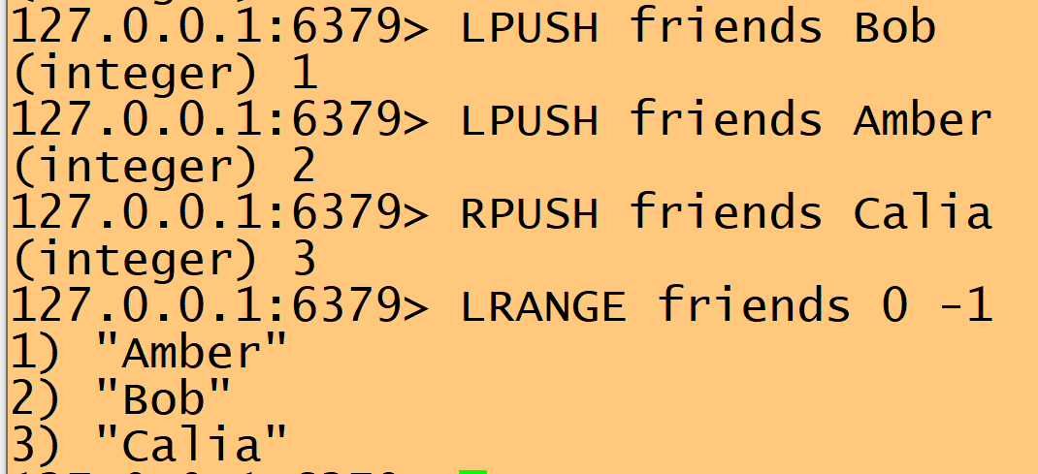
Storing Data Structures: Lists
Lists
Lists are a way to store related data. In Redis, a list is a linked list, which means write operations are very fast, but read operations tend to be slower.
Commands
LPUSH: push to head of list
RPUSH: push to tail of list
LRANGE: display values from n to m. (0 is start; -1 is end)

Slide 16
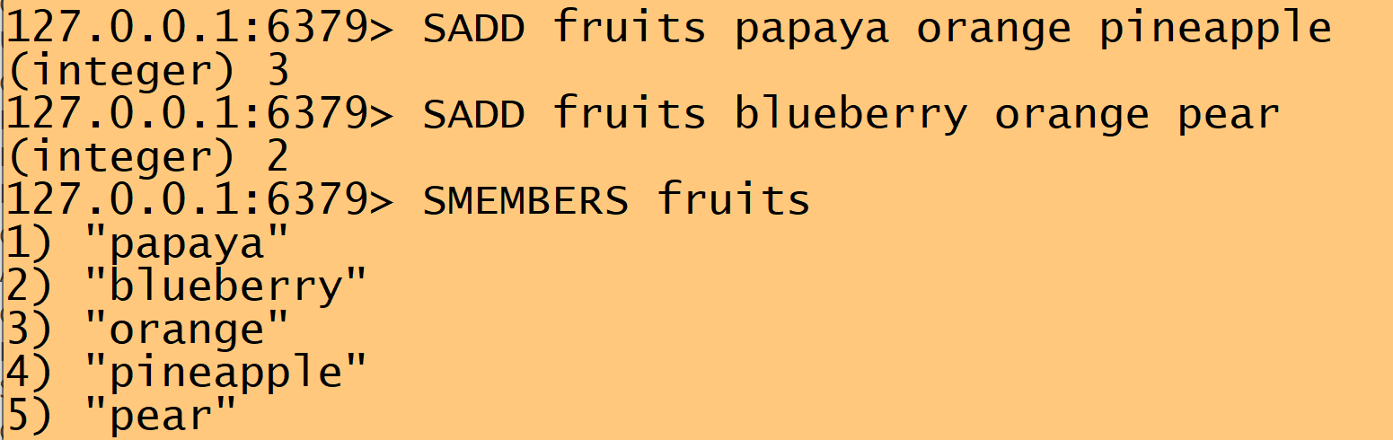

Storing Data Structures: Sets
Sets
Sets are not retrieved by position (index number), are not sorted, and do not allow duplicates
Commands
SADD: add to the set
SMEMBERS: see all members
SISMEMBER: check to see if value is a member of the set
pin

Slide 17
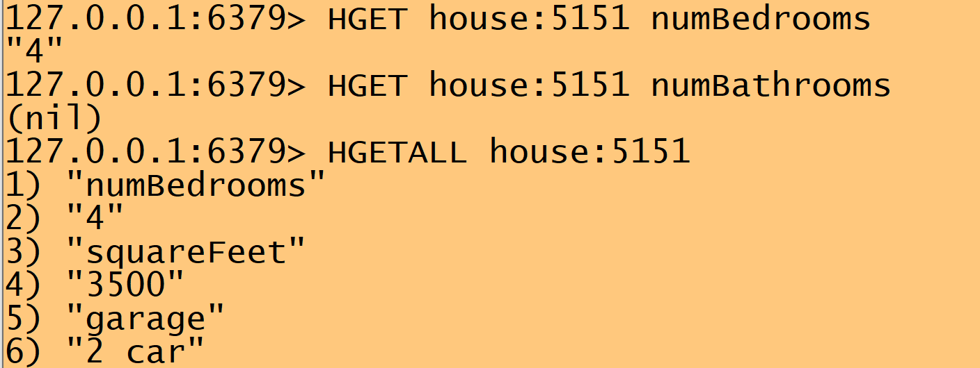
Storing Data Structures: Hashes
Hashes
Hashes are used to store collections of key/value pairs.
A hash has one key, but then within that structure are more fields and values.
Commands
HSET: add to the hash
HGET: get the value of one key of hash
HGETALL get all keys and values
the key of the hash
a key in the hash
Note the keys of the hashes contain colons.
Not needed but the equivalent of a namespace to help organize the Redis keys. The house ID used to add uniqueness to the hash key

Slide 18
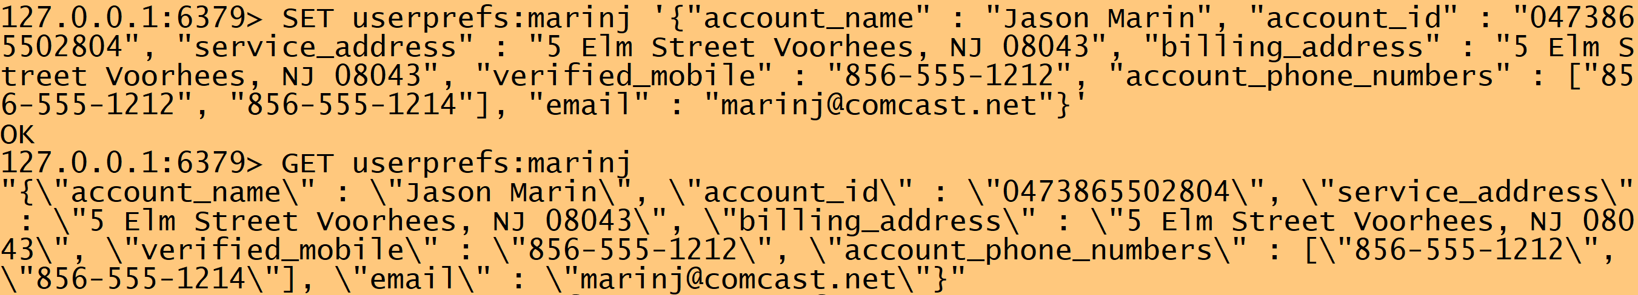
Storing Data Structures: JSON blobs (1)
JSON
A few options exist for storing JSON in Redis. The most basic form is to take a pre-serialized and simply store it at a specific key:
This, while seemingly simple, has some very real drawbacks:
The serialization takes client computational resources during read and write. [deserialize, change JSON key to a new value, and re-serialize]
The JSON format adds size to the data
Redis has only indirect ways to manipulate the actual JSON data.
Commands
Simple use of GET and SET
But value is JSON

Slide 19
Storing Data Structures: JSON blobs (2)
Redis has the ability to use modules.
ReJSON is a module that provides a special datatype and direct manipulation commands. ReJSON stores the data in a binary format which removes the storage overhead from JSON, provides quicker access to elements without de-/re-serialization times.
To use ReJSON you need to install it in your Redis server
Commands
Use JSON.GET and JSON.SET instead of GET and SET
JSON.SET <key> . <json string>
JSON.SET <key> <jsonKey> <value>
JSON.GET <key>
JSON.GET <key> <jsonKey>

Slide 20
JSON blobs vs. Hashes
RedisJSON is quite efficient, but not as fast as Redis hashes.

Slide 21
TYPE Command
<key> | TYPE <key> | Fetching data | GET / JSON.GET <key>
myKey | string | GET myKey | "("
friends | list | LRANGE friends 0 -1 | 1) "Amber" 2) "Bob" 3) "Calia"
fruits | set | SMEMBERS fruits | 1) "pear" 2) "pineapple" 3) "blueberry" 4) "orange" 5) "papaya"
house:5150 | hash | HGETALL house:5151 | 1) "numBedrooms" 2) "4" 3) "squareFeet" 4) "3500" 5) "garage" 6) "2 car"
userprefs:marinj | ReJSON-RL | JSON.GET userprefs:marinj | "{\"account_name\":\"Jason F. Marin\",\"account_id\": \"0473865502804 etc.

Slide 22
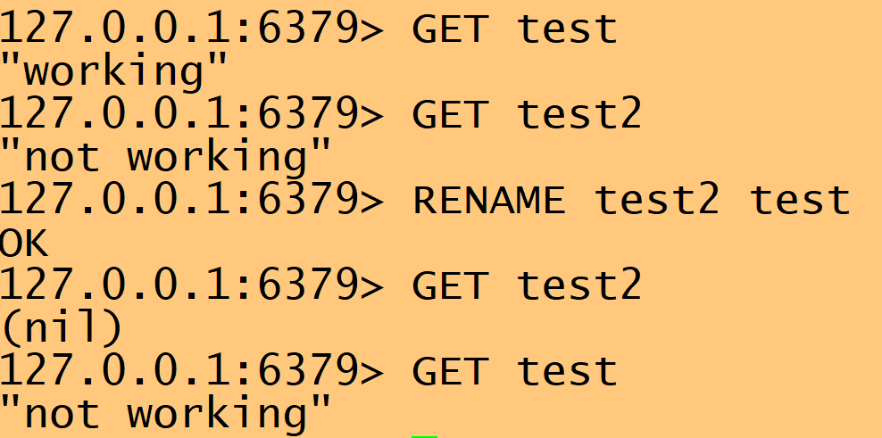
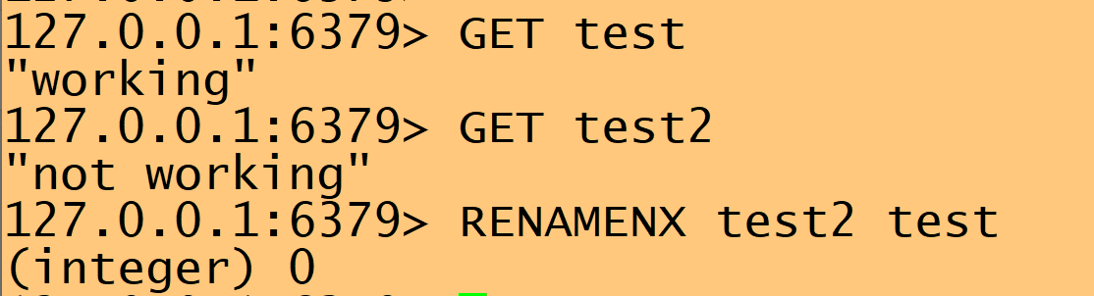
Other commands
DEL key
Deletes a key value pair
EXISTS key
Checks whether the key exists
RENAME key newkey
Changes the key name but is dangerous because it can overwrite
RENAMENX key newkey
Safer, won't do the rename if the newkey is inuse. (Note the 0 return)

Slide 23
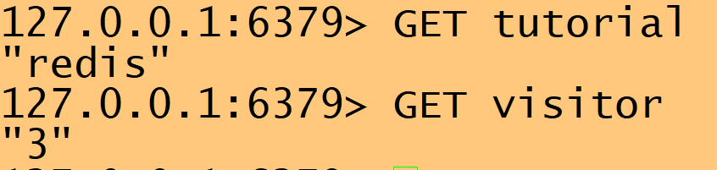
Redis Pipelining
Pipelining allows the client to send multiple requests to the server without waiting for the replies at all, and finally reads the replies in a single step.
The benefit of this technique is a drastically improved protocol performance. The speedup gained by pipelining ranges from a factor of five for connections to localhost up to a factor of at least one hundred over slower internet connections.
From tutorials point

Slide 24
PubSub

Slide 25
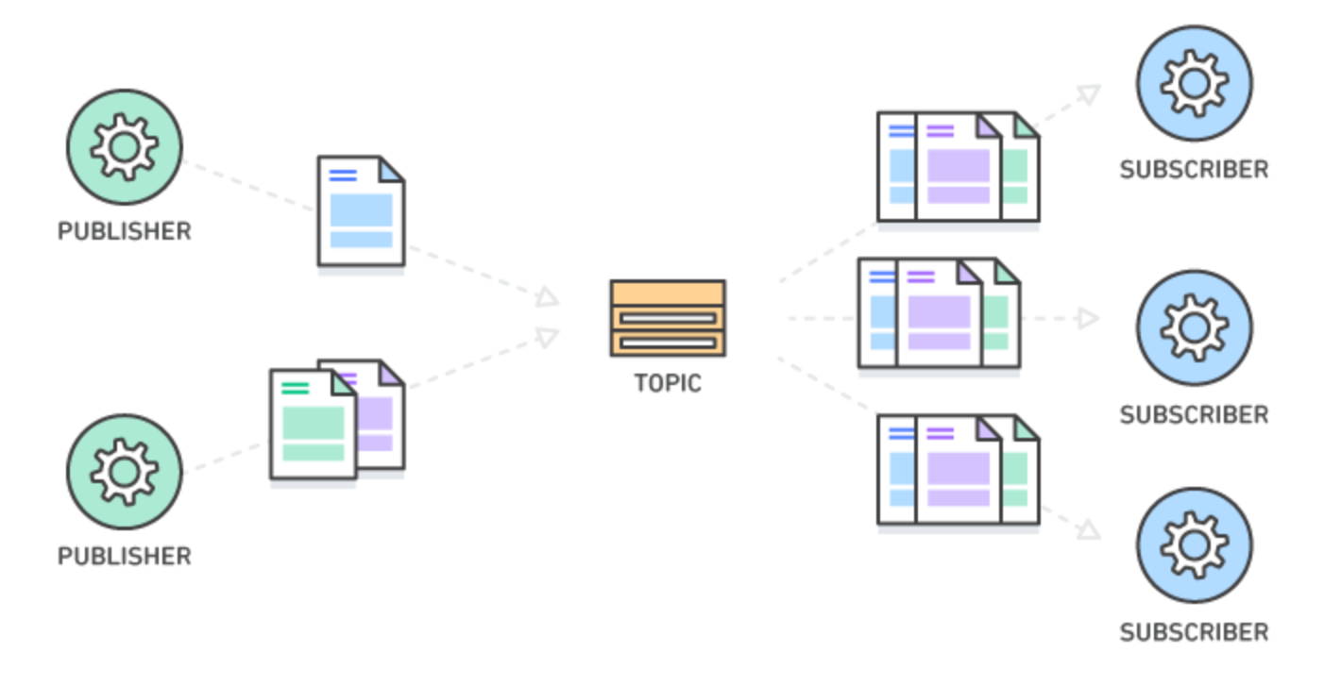
PubSub Models "Something produces a message and other things consume the message"
Redis is very good as the back-end of a PubSub model
Publish–subscribe is a messaging pattern where senders of messages, called publishers, do not program the messages to be sent directly to specific receivers, called subscribers, but instead categorize published messages into classes without knowledge of which subscribers, if any, there may be.
Similarly, subscribers express interest in one or more classes and only receive messages that are of interest, without knowledge of which publishers, if any, there are.
Near real-time processing – e.g., update value when an event occurs

Slide 26

Examples of Pub/Sub
Pub/Sub allows users to be alerted to updates on channels. When a message is published to a channel, Redis sends the message to all of the subscribers. This functionality has many uses for multi-user or social websites, mainly around notifications for chat messages, tweets, emails, and other events.
Library example
Instead of crunching the numbers and sending out emails to everyone whose book is overdue and has overdue fees, have a Python script running forever (as a daemon) which might be listening to Redis PubSub
Anytime a book goes overdue:
An email is immediately sent to the borrower.
An update request gets sent to a companion database (maybe MySQL)
Reddit
Somebody posts, "Obama just tweeted X" this could be posted to Redis
Subscribers would then be notified

Slide 27
PubSub with Redis
SUBSCRIBE, UNSUBSCRIBE and PUBLISH implement the Publish/Subscribe messaging paradigm
The decoupling of publishers and subscribers can allow for greater scalability and a more dynamic network topology.
For instance in order to subscribe to channels foo and bar the client issues a SUBSCRIBE providing the names of the channels:
SUBSCRIBE channel1 channel2
Messages sent by other clients to these channels will be pushed by Redis to all the subscribed clients.
A client subscribed to one or more channels should not issue commands, although it can subscribe and unsubscribe to and from other channels.

Slide 28
IPC (inter-process communication)

Slide 29
Redis for interprocess communication on a single node
For example, can be used for multiprocessing with Python
Every night we need to log into every single customer modem on the Comcast network – 30 million modems,
A non-Redis database could exist with a record that has an account ID, the modem IP address, and the type of modem
A Python script can access this database every night and go through all 30 million records
OR, we could send all 30 million pieces of data into a Redis key in a PubSub model with 500 Python processes sitting on the other end acting as a fleet or workers all doing the same job, but orchestrated by Redis.
Since all 500 Python processes share the same ID, they will only read each modem record once. So if one process reads a record, it wont be picked up by another process.
Key-value databases to the rescue: Information is all in memory, with a very quick caching layer

Slide 30
An example application in node.js

Slide 31
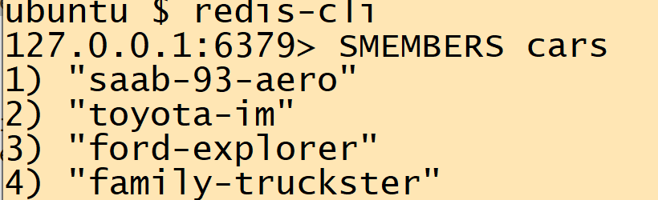
Combining URLs with Redis actions in Node.js
Using Node.js, you can relate the routes (paths) of URLs directed toward the node.js server (port 3000) to specific node.js files
For instance, in set.nodule.node.js,
// create a member in a set with REST
// PUT /mybase/mymember = SADD mybase mymember
router.put(
'/:member',
function(req,res,next) {
client.sadd(
req.params.base,
req.params.member,
responseHelper.sc200OnRedisSuccess(res,next)
);
}
);
The javascript app sets up the association between URL route "cars" and the redis set with the same name. Thus from PUT URLs like
curl -X PUT http://localhost:3000/cars/ford-explorer
set.nodule.node.js is called
Resulting in a redis SADD call
Resulting in the addition to the redis set

Slide 32
Index.js
The primary location for the front-end code is the file calledindex.js.
This file sets up the application for our use.
The index.js file uses a Node.js HTTP server that has routes backed by Redis calls.
The remaining code in index.js is used to route or direct clientto the proper location.
Even though the file is index.js, there is no default web page for this application.

Slide 33
Index.js (page 1)
const
argv = require('yargs') // 'yargs' manages command line arguments
.option('connection', {
description : 'Path to your connection object JSON file'
})
.demandOption(['connection'])
.argv,
express = require('express'), // 'express' is the HTTP server framework
redis = require('redis'), // 'node_redis' is the client library for redis
sortedHashRoutes = require('./sorted-hash.module.node.js'), // routes for a Hash + Zset combo
listRoutes = require('./list.module.node.js'), // these are the routes for a list
setRoutes = require('./set.module.node.js'), // these are the routes for a set
connection = require(argv.connection), // import the connection from the command line
// and make it into a JS object
client = redis.createClient(connection), // create the master client connection to Redis
keys = { // store our keys in one place
cars : 'cars',
features : 'features',
descriptions : 'cardescriptions'
},
server = express(); // create the server instance

Slide 34
Index.js (page 2)
// use this syntactical sugar to pass in a base route that also determines // the root of the redis key
function baseRoute(str) { return '/:base('+str+')'; }
// give the clients to the different routes
sortedHashRoutes.setClient(client); // Uses sorted-hash.module.node.js for Redis hash
listRoutes.setClient(client); // Uses list.module.node.js for Redis list
setRoutes.setClient(client); // Uses set.module.node.js for Redis set
// plumb in the sub-routers which will
server.use(baseRoute(keys.descriptions),sortedHashRoutes.router); // descriptions - hash
server.use(baseRoute(keys.features),listRoutes.router); // features will be Redis list
server.use(baseRoute(keys.cars),setRoutes.router); // cars will be a Redis set
server.listen(3000,function() { // start the server at port 3000
console.log('CRUD App Running.'); // notify the console that we're up and ready
});

Slide 35
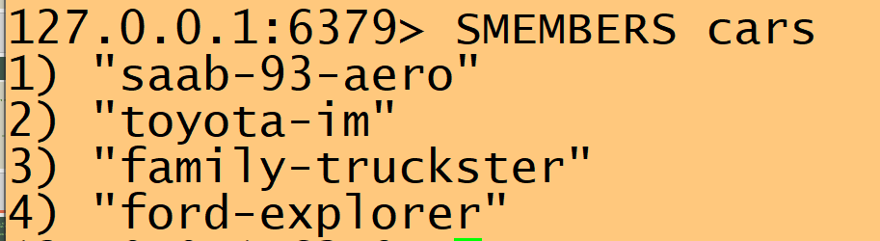
A sample shell script
-d, --data <data>
Sends the specified data in a POST request to the HTTP server, as a browser does when users press submit from an HTML form.
-X, --request <command>
Specifies a custom request method to use when communicating with the HTTP server.
-H, --header <header/@file>
Extra header to include in the request when sending HTTP to a server.
cars will be a Redis set
curl -X PUT http://localhost:3000/cars/ford-explorer
curl -X PUT http://localhost:3000/cars/toyota-im
curl -X PUT http://localhost:3000/cars/saab-93-aero
curl -X PUT http://localhost:3000/cars/family-truckster
Key of the set
Member of the set

Slide 36
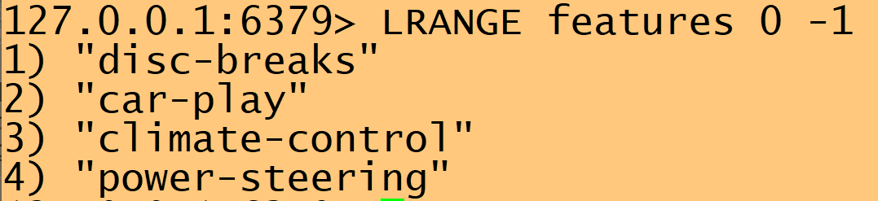
A sample shell script
-d, --data <data>
Sends the specified data in a POST request to the HTTP server, as a browser does when users press submit from an HTML form.
-X, --request <command>
Specifies a custom request method to use when communicating with the HTTP server.
-H, --header <header/@file>
Extra header to include in the request when sending HTTP to a server.
features will be a Redis list
curl -X POST http://localhost:3000/features/power-steering
curl -X POST http://localhost:3000/features/climate-control
curl -X POST http://localhost:3000/features/car-play
curl -X POST http://localhost:3000/features/disc-breaks
Key of the list
Member of the list

Slide 37
A sample shell script
-d, --data <data>
Sends the specified data in a POST request to the HTTP server, as a browser does when users press submit from an HTML form.
-X, --request <command>
Specifies a custom request method to use when communicating with the HTTP server.
-H, --header <header/@file>
Extra header to include in the request when sending HTTP to a server.
cardescriptions will be a Redis hash
curl -d '{ "colour" : "yellow", "style" : "SUV", "year": 2018 }' -H "Content-Type: application/json" -X POST http://localhost:3000/cardescriptions/
curl -d '{ "colour" : "green", "style" : "hatchback", "year": 2017 }'
-H "Content-Type: application/json"
-X POST http://localhost:3000/cardescriptions/
curl -d '{ "colour" : "blue", "style" : "sedan", "year": 2008 }'
-H "Content-Type: application/json"
-X POST http://localhost:3000/cardescriptions/
curl -d '{ "colour" : "brown", "style" : "station-wagon", "year": 1983 }'
-H "Content-Type: application/json"
-X POST http://localhost:3000/cardescriptions/

Slide 38
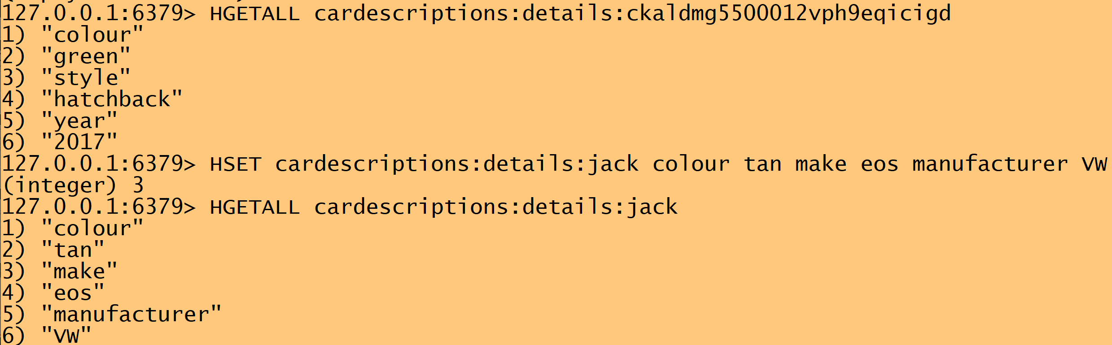
A sample shell script
-d, --data <data>
Sends the specified data in a POST request to the HTTP server, as a browser does when users press submit from an HTML form.
-X, --request <command>
Specifies a custom request method to use when communicating with the HTTP server.
-H, --header <header/@file>
Extra header to include in the request when sending HTTP to a server.
cardescriptions will be a Redis hash
curl -d '{ "colour" : "green", "style" : "hatchback", "year": 2017 }'
-H "Content-Type: application/json"
-X POST http://localhost:3000/cardescriptions/
curl -d '{ "colour" : "blue", "style" : "sedan", "year": 2008 }'
-H "Content-Type: application/json"
-X POST http://localhost:3000/cardescriptions/
curl -d '{ "colour" : "brown", "style" : "station-wagon", "year": 1983 }'
-H "Content-Type: application/json"
-X POST http://localhost:3000/cardescriptions/
node.js call determines the key
Make a new hash using Redist, following the same "namespace" rules for key

